Slide 1
ENCODER
Prepared By
Mr.P.KANAKARAJ
AP/EEE
SRMIST-KTR

Slide 2
Encoder:
It is a combinational logic circuit.
An encoder has 2^{n} input lines and n output lines.
The n output lines generate the binary code for the possible 2^{n} input lines.
Input – 2^{n}
Output – n
Encoder – 2^{n} : n
2^{n}:n
Encoder
2^{n}
Input Lines
n
Output Lines

Slide 3




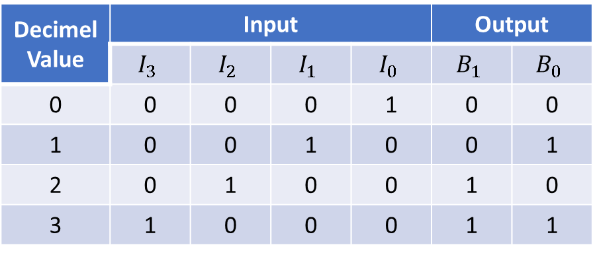





Four to Two Line Binary Encoder
Truth Table
$$I_{3}$$
$$I_{2}$$
$$I_{1}$$
$$I_{0}$$
Decimel Value | Input |  |  |  | Output
 | $$I_{3}$$ | $$I_{2}$$ | $$I_{1}$$ | $$I_{0}$$ | $$B_{1}$$ | $$B_{0}$$
0 | 0 | 0 | 0 | 1 | 0 | 0
1 | 0 | 0 | 1 | 0 | 0 | 1
2 | 0 | 1 | 0 | 0 | 1 | 0
3 | 1 | 0 | 0 | 0 | 1 | 1
$$B_{0}$$
Input – 4
Output – 2
Outputs are,
$$B_{1}$$
$$B_{0}=I_{2}+I_{3}$$
$$B_{1}=I_{1}+I_{3}$$

Slide 4









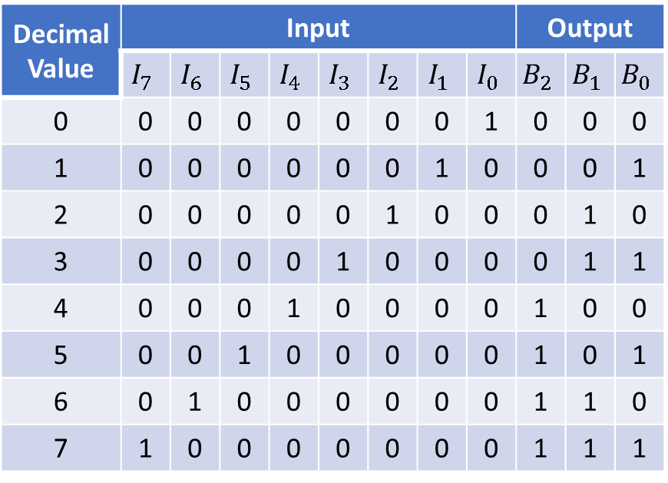

















Eight to Three Line Binary Encoder (Octal to Binary Encoder
Truth Table
$$I_{7}$$
$$I_{6}$$
$$I_{5}$$
$$I_{4}$$
$$I_{3}$$
$$I_{2}$$
$$I_{1}$$
$$I_{0}$$
Decimal Value | Input |  |  |  |  |  |  |  | Output
 | $$I_{7}$$ | $$I_{6}$$ | $$I_{5}$$ | $$I_{4}$$ | $$I_{3}$$ | $$I_{2}$$ | $$I_{1}$$ | $$I_{0}$$ | $$B_{2}$$ | $$B_{1}$$ | $$B_{0}$$
0 | 0 | 0 | 0 | 0 | 0 | 0 | 0 | 1 | 0 | 0 | 0
1 | 0 | 0 | 0 | 0 | 0 | 0 | 1 | 0 | 0 | 0 | 1
2 | 0 | 0 | 0 | 0 | 0 | 1 | 0 | 0 | 0 | 1 | 0
3 | 0 | 0 | 0 | 0 | 1 | 0 | 0 | 0 | 0 | 1 | 1
4 | 0 | 0 | 0 | 1 | 0 | 0 | 0 | 0 | 1 | 0 | 0
5 | 0 | 0 | 1 | 0 | 0 | 0 | 0 | 0 | 1 | 0 | 1
6 | 0 | 1 | 0 | 0 | 0 | 0 | 0 | 0 | 1 | 1 | 0
7 | 1 | 0 | 0 | 0 | 0 | 0 | 0 | 0 | 1 | 1 | 1
$$B_{0}$$
$$B_{1}$$
Input – 8
Output – 3
Outputs are,
$$B_{2}$$
$$B_{0}=$$
$$I_{1}$$
$${+I}_{3}$$
$${+I}_{5}$$
$${+I}_{7}$$
$$B_{1}=$$
$$I_{2}$$
$${+I}_{3}$$
$${+I}_{6}$$
$${+I}_{7}$$
$$B_{2}=$$
$$I_{4}$$
$${+I}_{5}$$
$${+I}_{6}$$
$${+I}_{7}$$

Slide 5








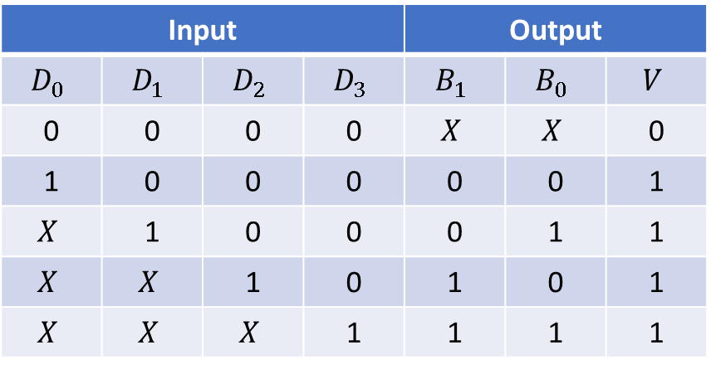














Priority Encoder:
$$B_{1}:$$
K-Map Simplification
$$B_{0}:$$
$$D_{2}D_{3}$$
$$D_{2}D_{3}$$
It is an encoder circuit that includes the priority function.
In that priority encoder, if two or more inputs are equal to 1 at the same time, the input having the highest priority will take precedence.
 | 00 | 01 | 11 | 10
00 | X | 1 | 1 | 1
01 | 0 | 1 | 1 | 1
11 | 0 | 1 | 1 | 1
10 | 0 | 1 | 1 | 1
 | 00 | 01 | 11 | 10
00 | X | 1 | 1 | 0
01 | 1 | 1 | 1 | 0
11 | 1 | 1 | 1 | 0
10 | 0 | 1 | 1 | 0
$$D_{0}D_{1}$$
$$D_{0}D_{1}$$
$$D_{1}$$
$$B_{1}=$$
$$D_{2}$$
$$+ D_{3}$$
$$B_{0}=$$
$$+$$
Truth Table
$$D_{3}$$
$$\overline{D_{2}}$$
$$V:$$
Input |  |  |  | Output
$$D_{0}$$ | $$D_{1}$$ | $$D_{2}$$ | $$D_{3}$$ | $$B_{1}$$ | $$B_{0}$$ | $$V$$
0 | 0 | 0 | 0 | $$X$$ | $$X$$ | 0
1 | 0 | 0 | 0 | 0 | 0 | 1
$$X$$ | 1 | 0 | 0 | 0 | 1 | 1
$$X$$ | $$X$$ | 1 | 0 | 1 | 0 | 1
$$X$$ | $$X$$ | $$X$$ | 1 | 1 | 1 | 1
$$D_{2}D_{3}$$
 | 00 | 01 | 11 | 10
00 | 0 | 1 | 1 | 1
01 | 1 | 1 | 1 | 1
11 | 1 | 1 | 1 | 1
10 | 1 | 1 | 1 | 1
$$D_{0}D_{1}$$
$$V=$$
$$D_{0}$$
$$+ D_{1}$$
$$+ D_{2}$$
$$+ D_{3}$$

Slide 6
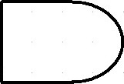























Logic Diagram for Priority Encoder
Expressions are,
$$D_{3}$$
$$D_{2}$$
$$D_{1}$$
$$D_{0}$$
$$B_{1}=$$
$$D_{2}$$
$$+ D_{3}$$
$$B_{1}$$
$$D_{1}$$
$$B_{0}=$$
$$+$$
$$D_{3}$$
$$\overline{D_{2}}$$
$$V=$$
$$D_{0}$$
$$+ D_{1}$$
$$+ D_{2}$$
$$+ D_{3}$$
$$D_{1}$$
$$\overline{D_{2}}$$
$$B_{0}$$
$$V$$

Slide 7
THANK YOU…

Slide 8
ANY QUERIEES???…

